Slide 1

SOC Virtual Lab
By Gabriel Antonio Zepeda

Slide 2
Table of Contents
SOC Analyst
Project - Security Operations Center (SOC) Virtual Lab

Slide 3

SOC Analyst

Slide 4


SOC Analyst
A SOC Analyst (Security Operations Center Analyst)
A cyber security professional responsible for
Monitoring,
Detecting
Investigating
Triage security incidents within an organization.
They work inside a Security Operations Center (SOC), which is the command hub for defending an organization’s digital infrastructure.

Slide 5
Why Cybersecurity
Rationale
Digital Detective
Flexibility & Growth
Engaging
As a cyber threat hunter the idea of protecting people & organizations appeals to me. A clear sense of mission.
High demand / job security with a large range of roles and opportunities. 1000+ jobs daily.
The real incidents which happen keep the job dynamic, no two incidents will be truly the same.

Slide 6
Project
SOC Virtual Lab
A simulated security operations environment

Slide 7
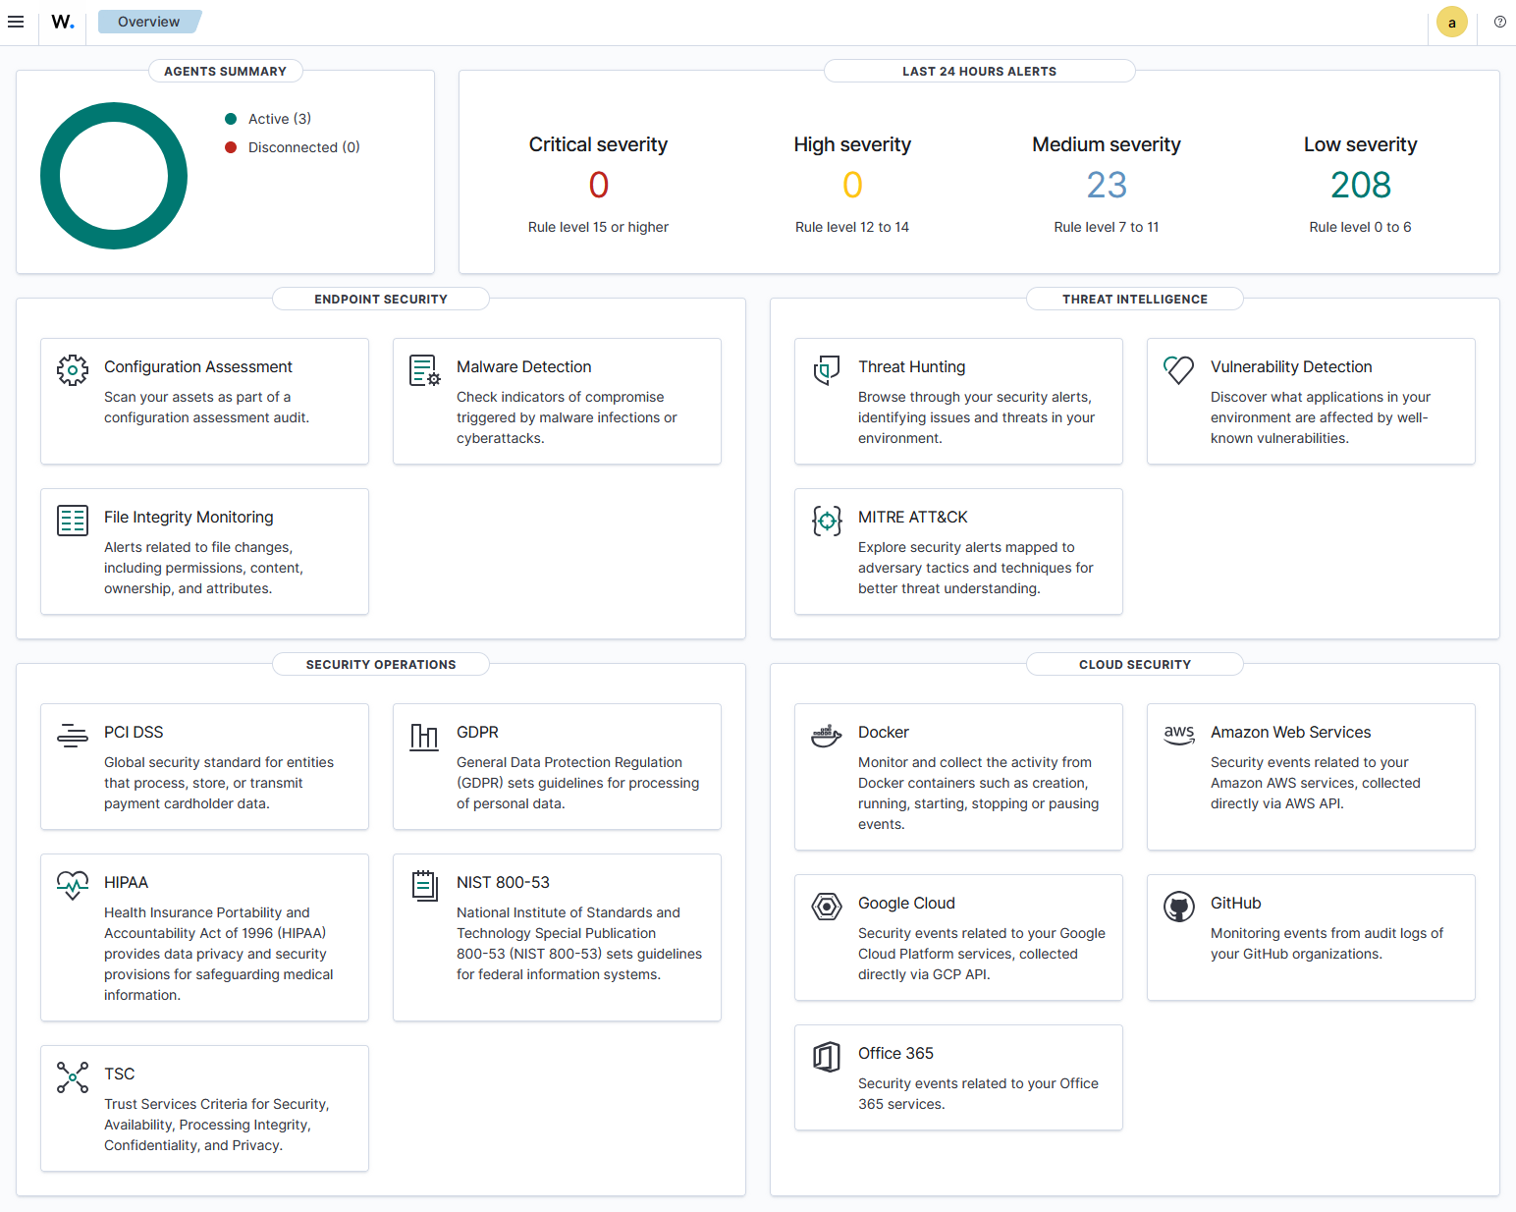
Project
What is a Virtual Lab?
The goal is to create a virtual environment which can be used to test multiple simulated attacks. Mainly for learning purposes and mastery of malicious attacks, detectionm, and remediation techniques.

Slide 8
Project
Key Concepts
Virtual Machines & Operating Systems
Security Information Event Managers
Malicious Attack Vectors & Techniques
- Rulesets - Correlation - Playbooks
SOC Report Documentation
Digital Forensics & Attacker Timelines (TTP)

Slide 9
Project
Schedule
May
June
July
August
September
October
PHASE 1
June 5th - August 20th
Task 1 – Attack Vectors
June 5th – June 9th
Task 2 – SIEM Rulesets
July 7th – July 10th
PHASE 2
Task 1 – Automated Correlation
Aug 25th – Oct 9th
Aug 25th - Aug 28th
Task 2 – Playbooks
Aug 25th – Oct 2nd

Slide 10
Project
Research
Testing
Analysis
Documentation
Deciding ADR and simulated attacks
Implementing my lab, simulated attacks, and SIEM software
Compile logs, establish rulesets, and playbooks
Create a professional report on each attack vector based on industry standard legal and ethical compliance

Slide 11
Project

Slide 12

Thanks!
Thank You!

